Slide 1
Gear Up and Explore
TEAM NAME: GLADIATORS
Team Members:
Dimpi Dedhia (NUID - 001342018)
Dhruvil Shah (NUID - 001873437)

Slide 2
Problem Statement
In this digital world, everyone is engrossed into their gadgets with almost zero scope of going out for an enthralling adventure in the Nature. It is a universal fact that going out in the natural landscape is good for an individual in terms of spirituality, mental health and fitness
The Aim is to develop something for the Users to make them proactively participate for working on improving their health.

Slide 3
Solution to Problem
We came up with a solution to develop a one-stop application where a user can get to shop exclusive gears and accessories and work on being fit at the same time.
The application will have a hiking organization that explores, writes and document treks. Through this application users can access numerous treks around the United States of America and book hikes organized by the organization.

Slide 4
Approach
The application aims to simplify the where to? and how to? questions of an individual with a goal to summit a peak.
By understanding customer convenience, we embedded an enterprise that works on buying and renting sports equipment.
This application reduces a user’s hassle of going to different places for booking a trek and buying equipment for the trek. This in turn also helps to generate revenue for the two enterprises as customers of hiking company tend to buy trek gears from the sports equipment store and vice versa

Slide 5
Use Case
Journey to Nature - A Trek Organizing Company:
Addition of hikes with required information such as trail name, duration, itinerary, directions, equipment required for the trek, difficulty level, location and weather.
Updating the available hikes present in the database.
Booking tab for users to book a trail of choice
Assigning trek leaders for hikes and maintaining it in the database.
Sending emails for booking confirmation users.
Generating dashboards for popular treks, peak months for hiking, average age of individuals booking a specific trek.

Slide 6
Use Case
GearUp – A Sports Equipment Store:
Addition of products of various kinds of sports that include trek gears.
Updating the price and details of existing product.
Selling sports equipment to customers using a well-designed product catalogue.
Maintaining sales data and revenue of the organization.
Invoice generation for every order via email confirmation.
Recommending treks according to the type of product bought.
Generating dashboards for popular products, brands, revenue of different categories of sports products.

Slide 7
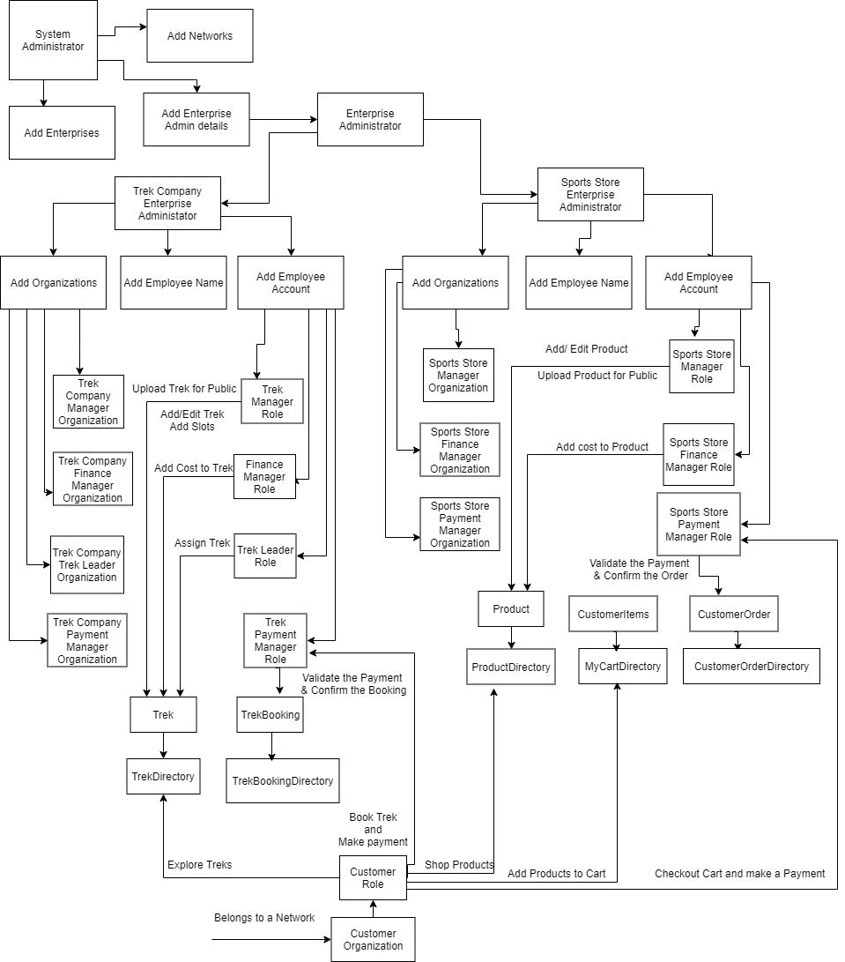
Object Model

Slide 8
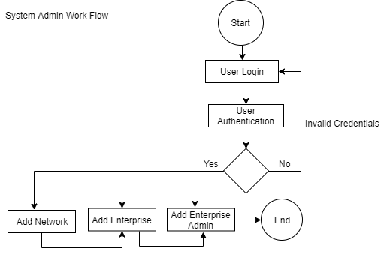
System Admin Work Flow

Slide 9
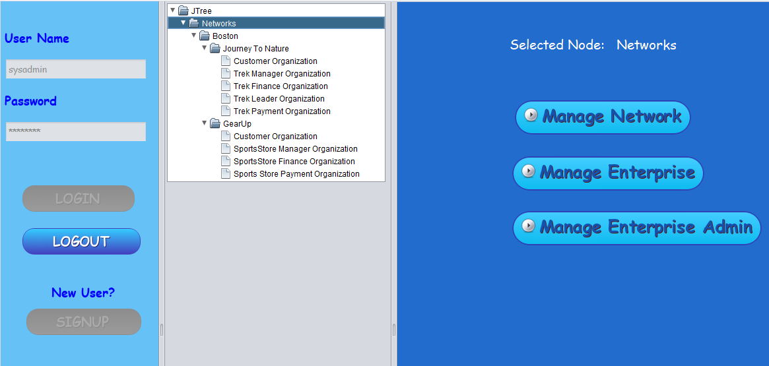
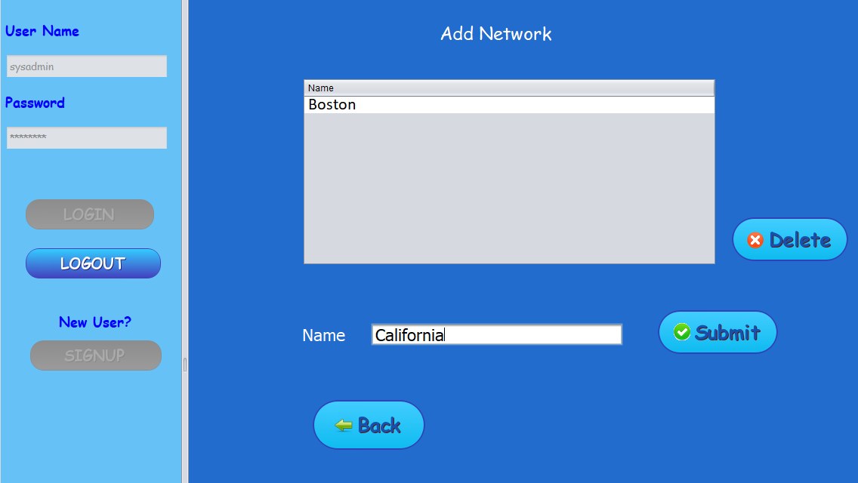
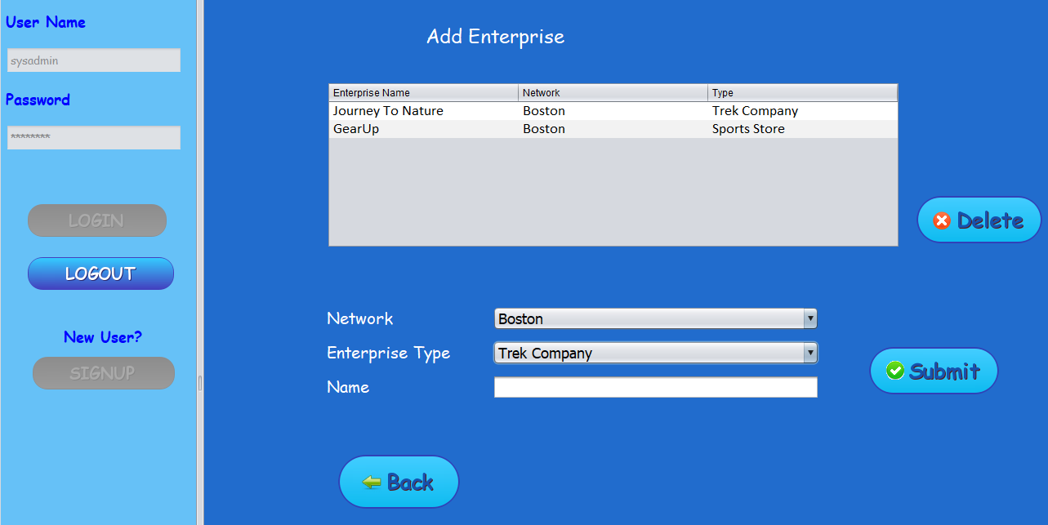
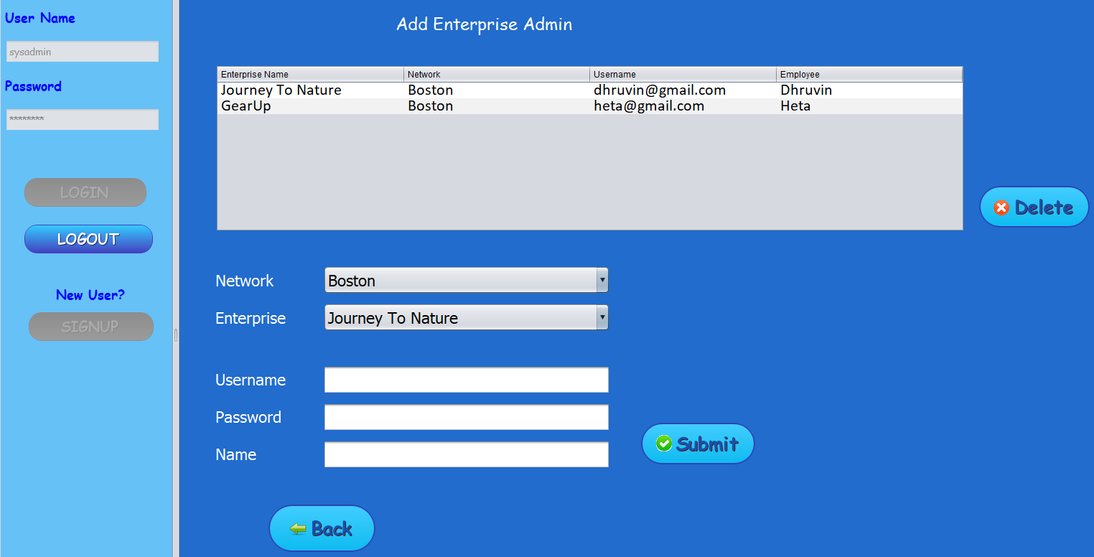
System Admin Work Flow

Slide 10
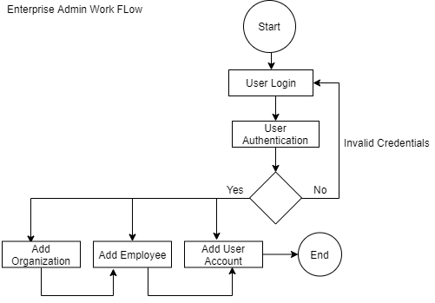
Enterprise Admin Work Flow

Slide 11
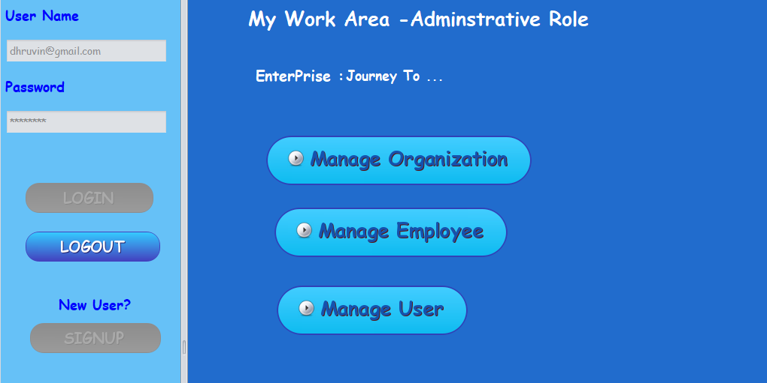
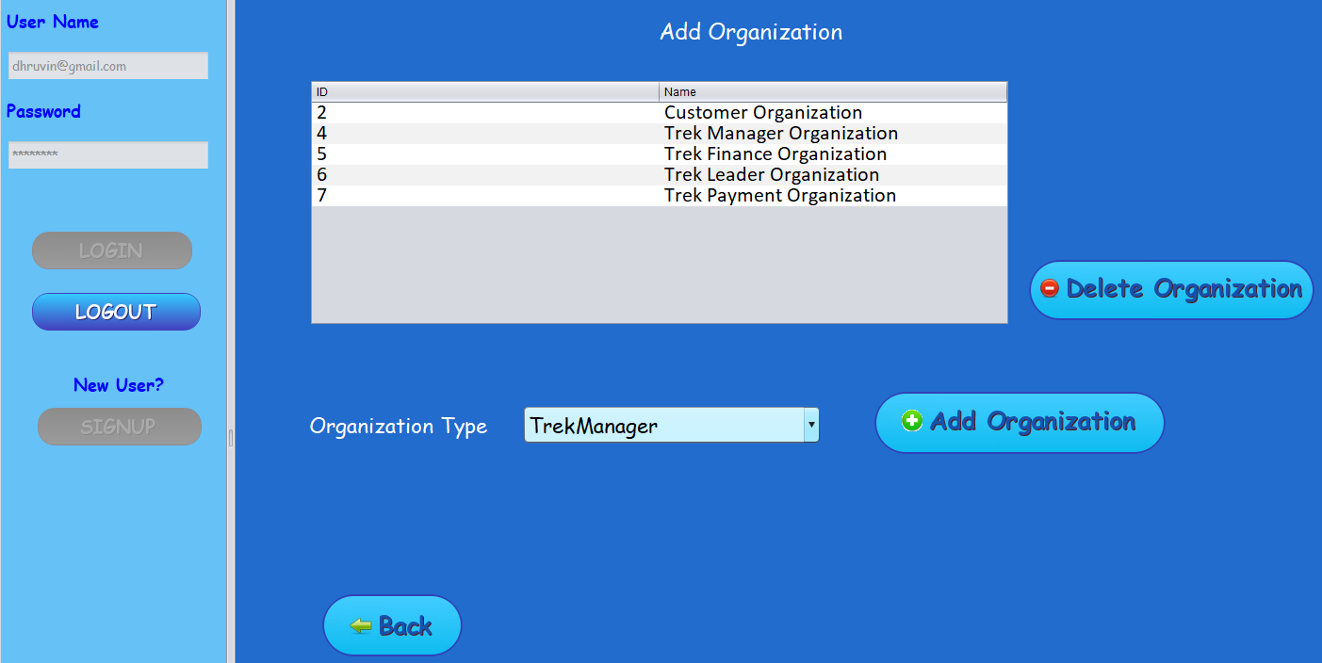
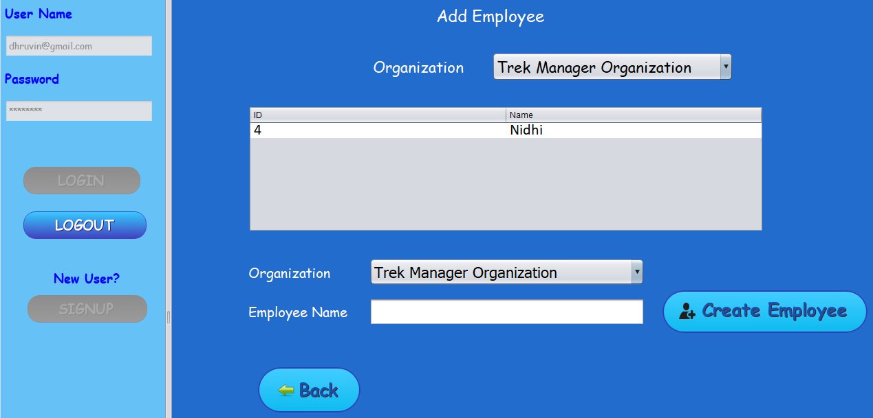
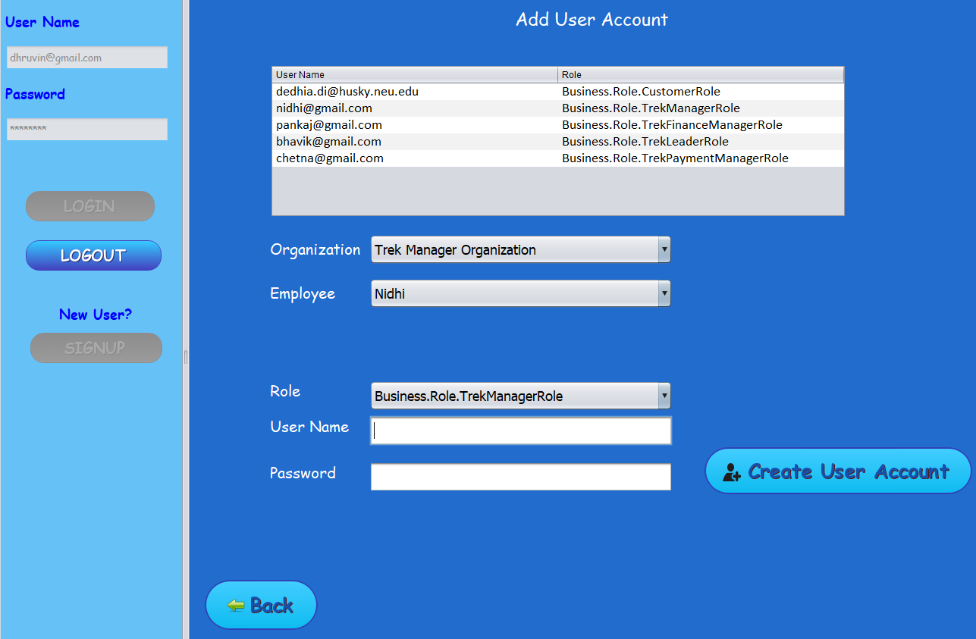
Enterprise Admin Work Flow

Slide 12
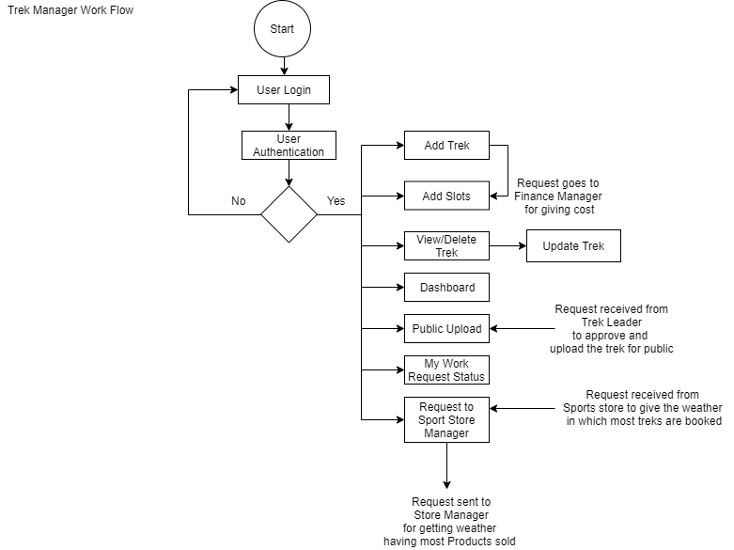
Trek Manager Work Flow

Slide 13
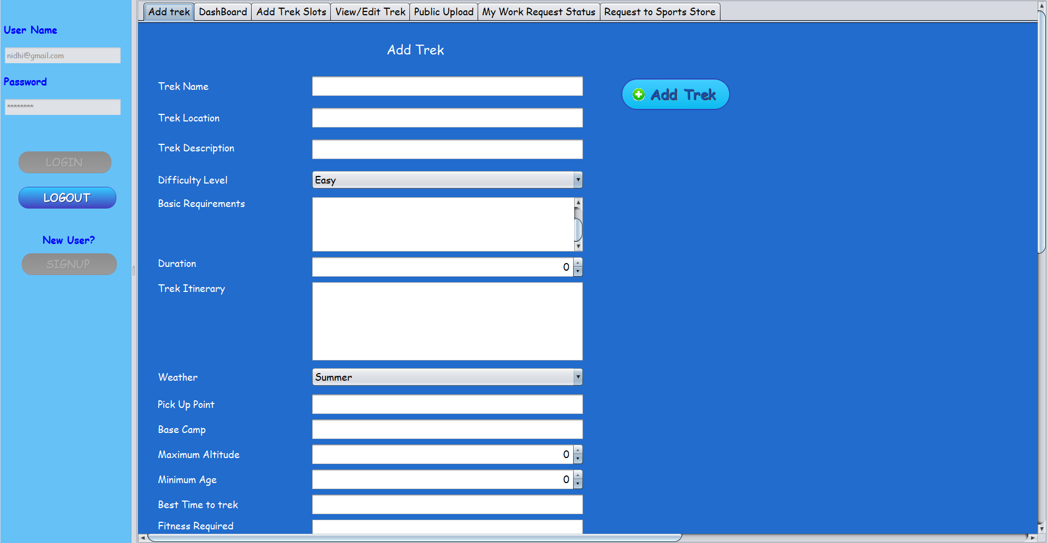
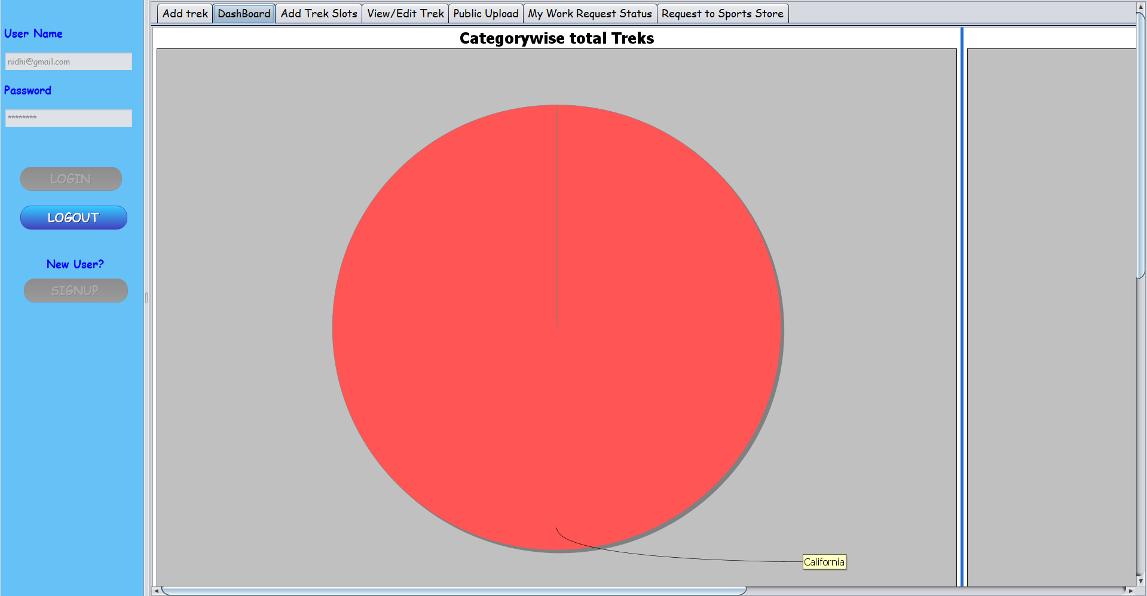
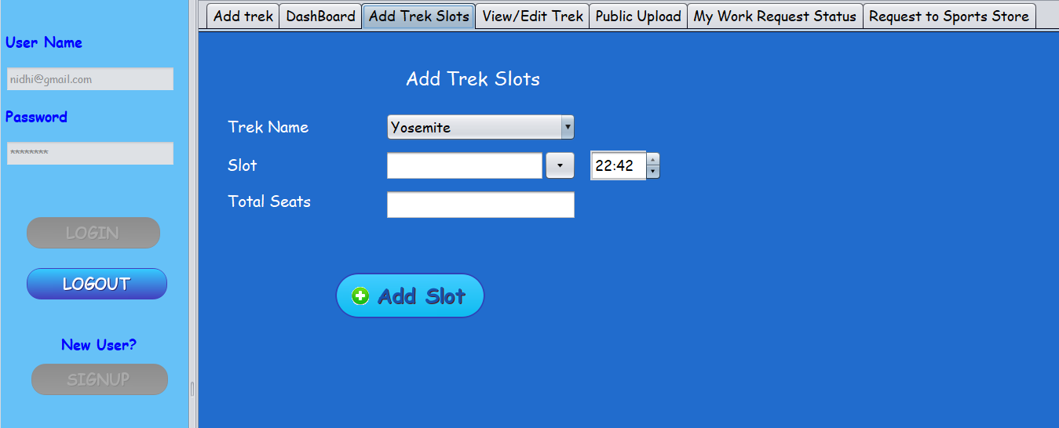
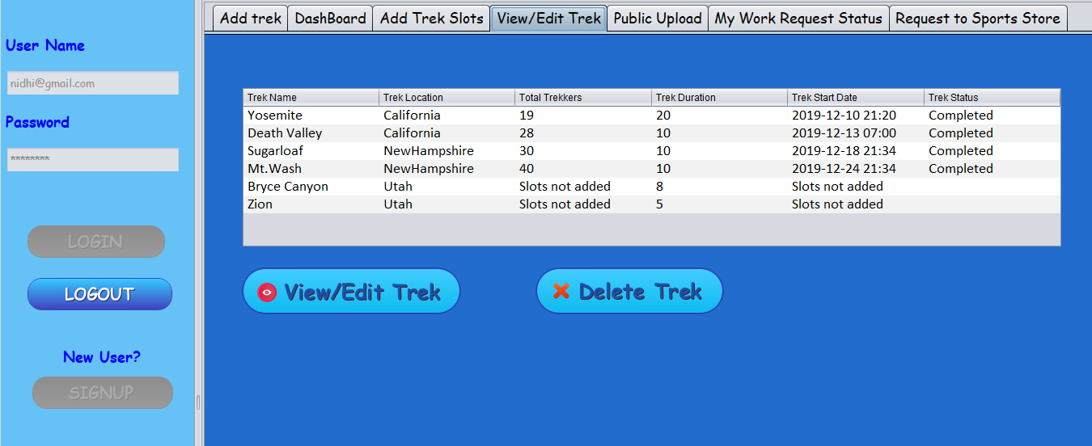
Trek Manager Work Flow

Slide 14
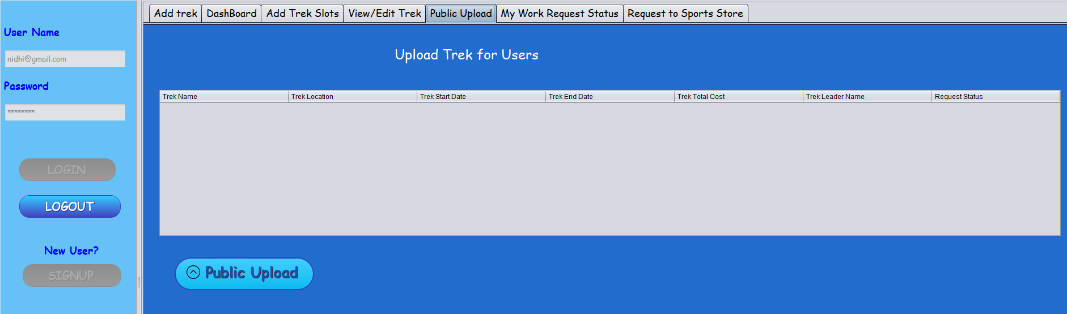
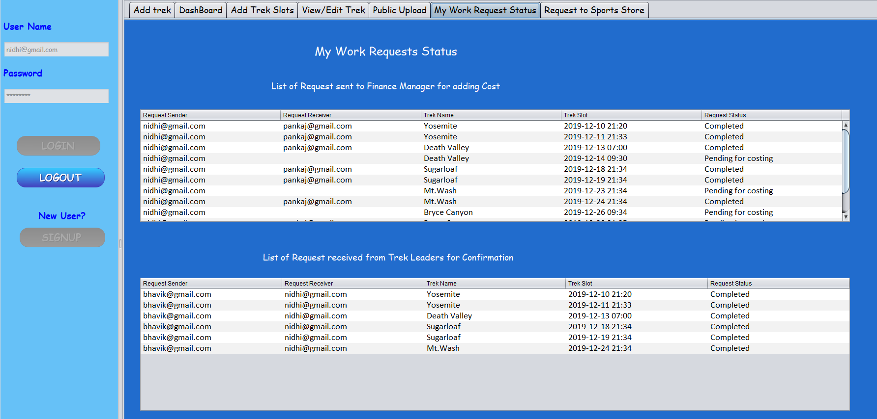
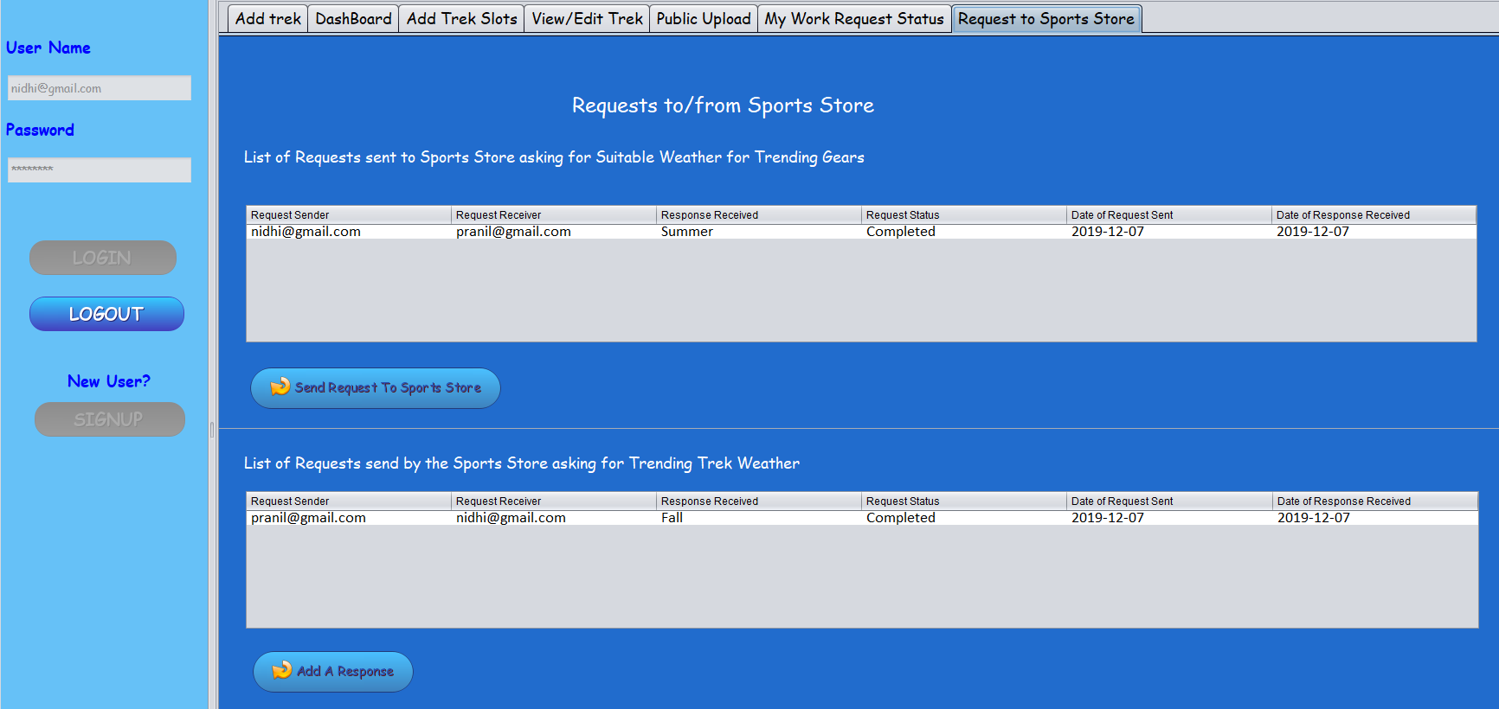
Trek Manager Work Flow

Slide 15
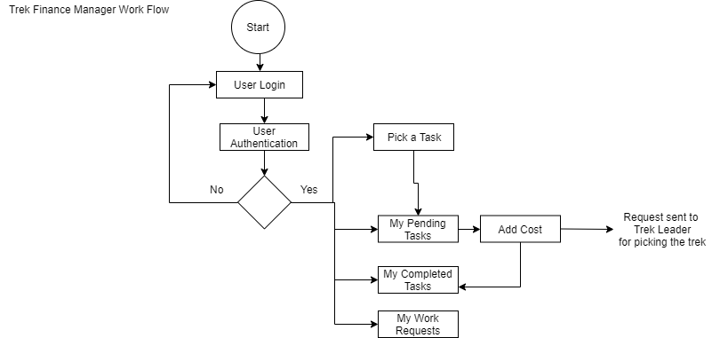
Trek Finance Manager Work Flow

Slide 16
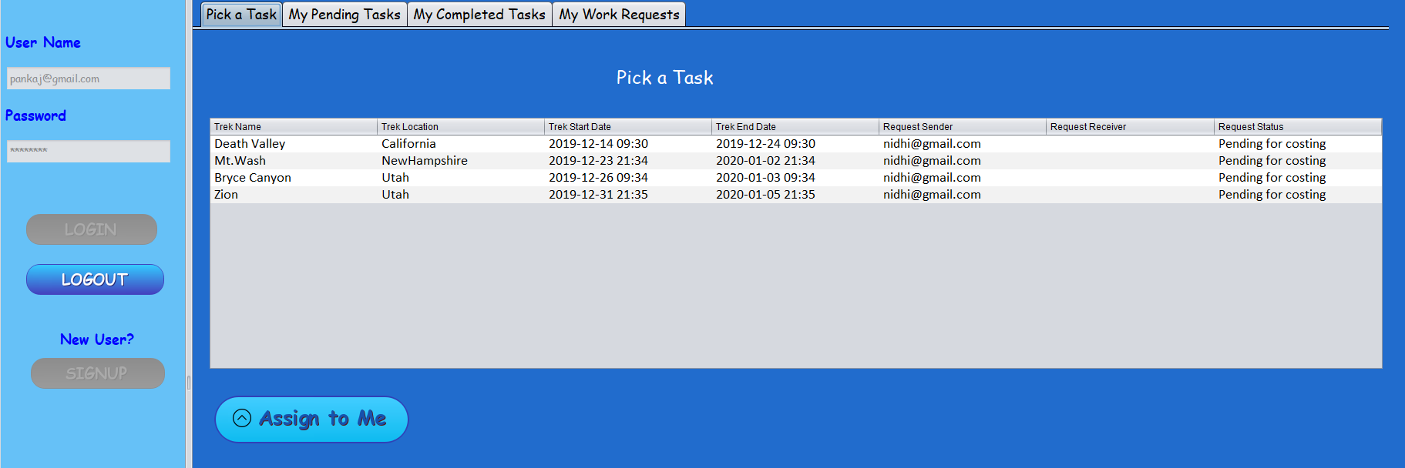
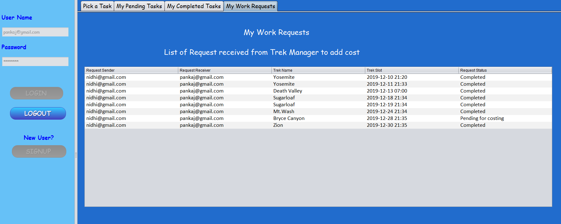
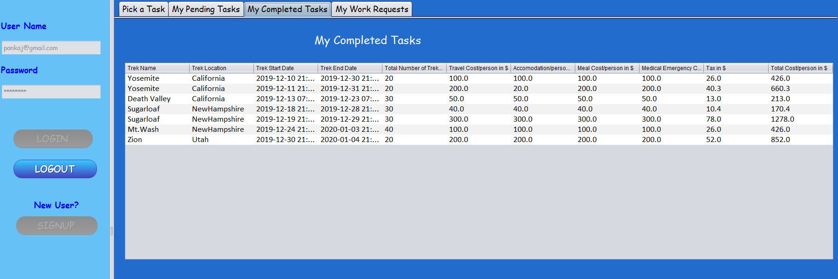
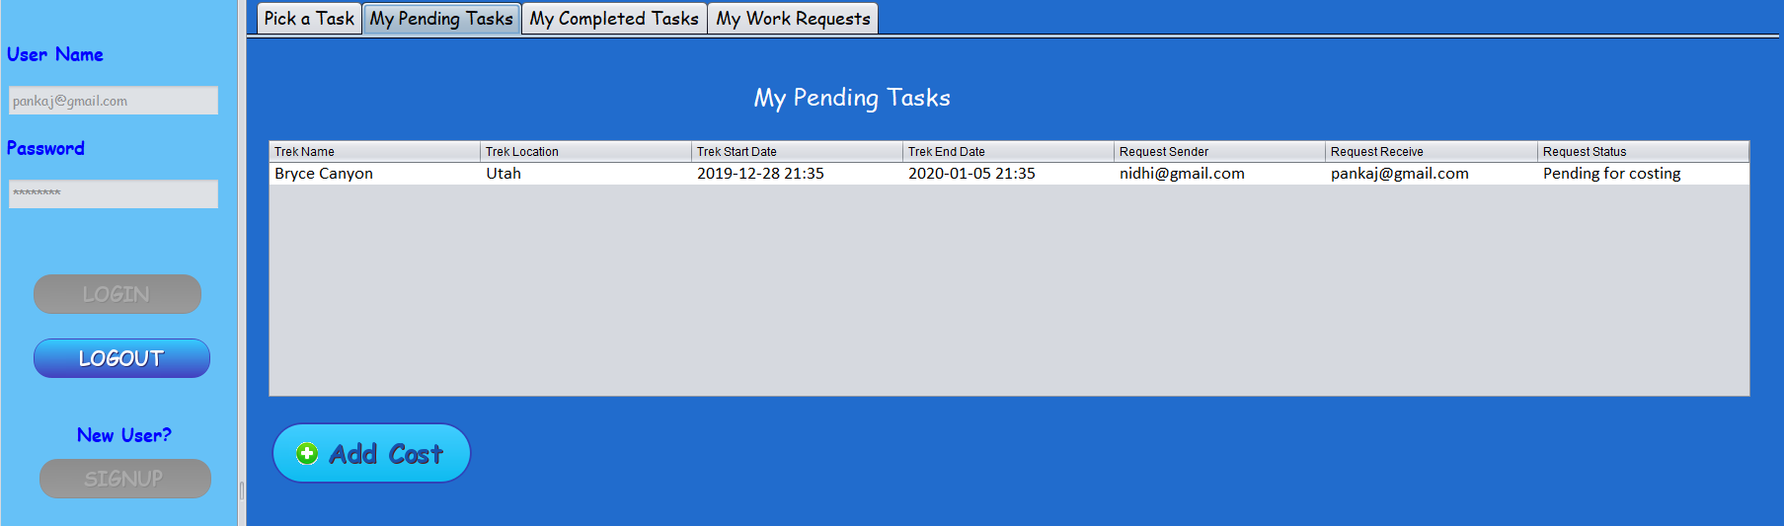
Trek Finance Manager Work Flow

Slide 17
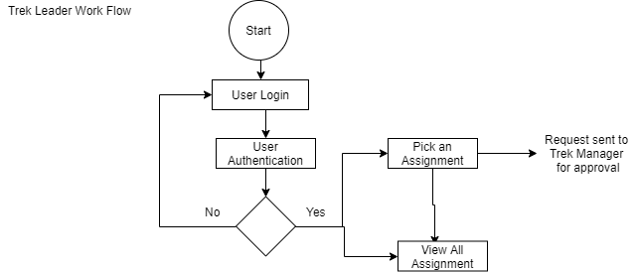
Trek Leader Work Flow

Slide 18
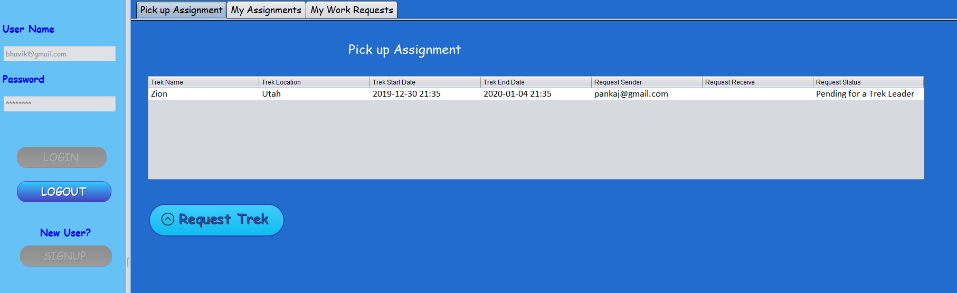
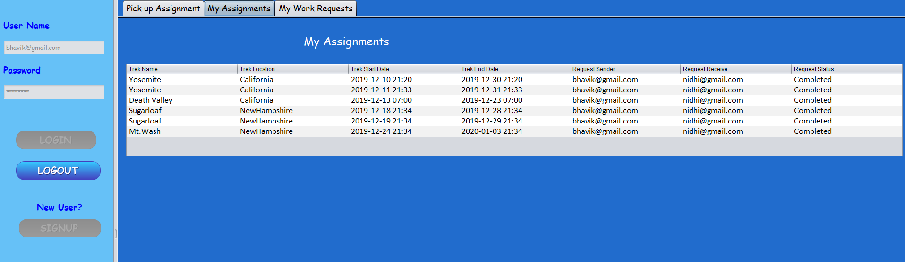
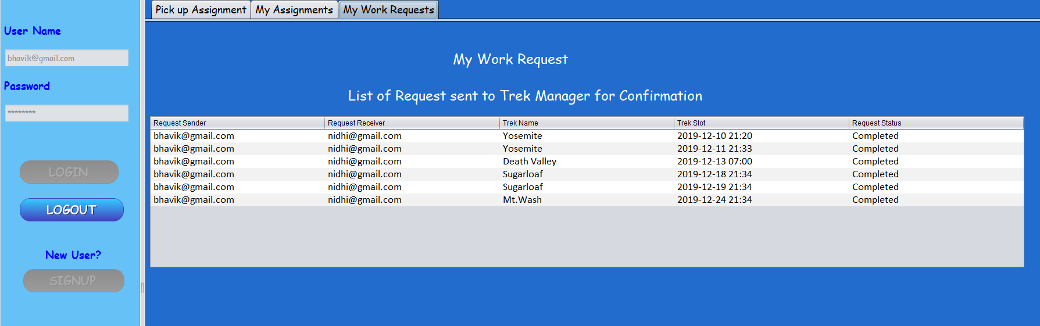
Trek Leader Work Flow

Slide 19
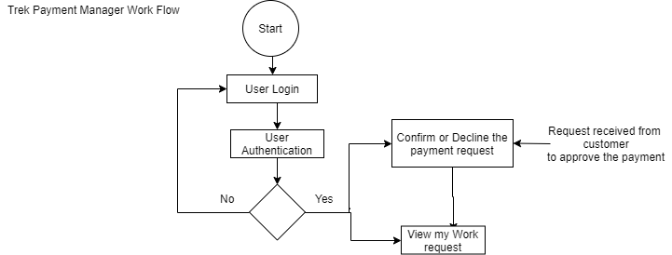
Trek Payment Manager Flow

Slide 20
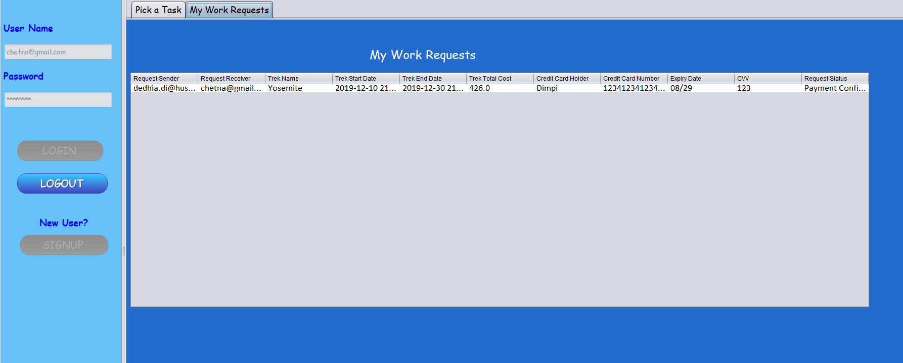
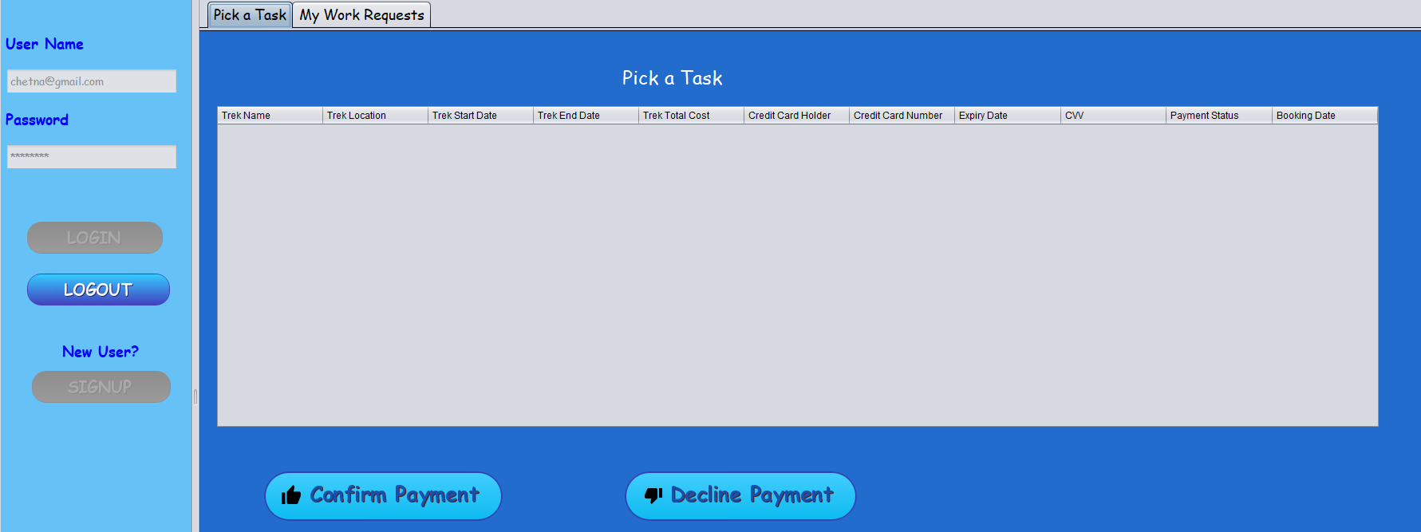
Trek Payment Manager Flow

Slide 21
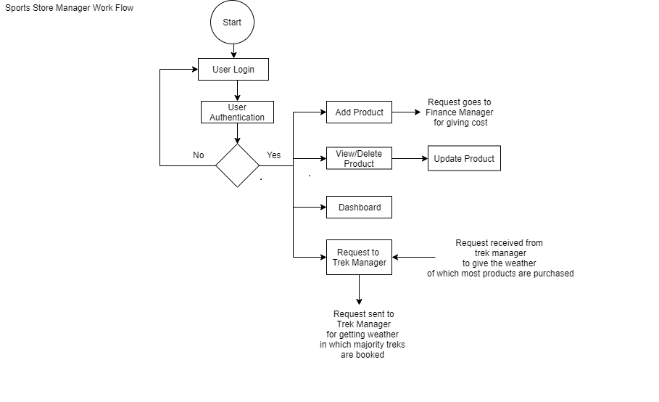
Sports Store Manager Work Flow

Slide 22
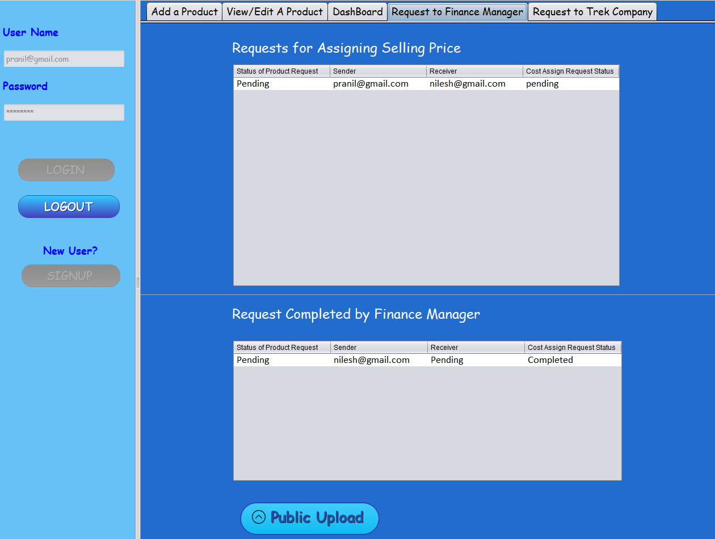
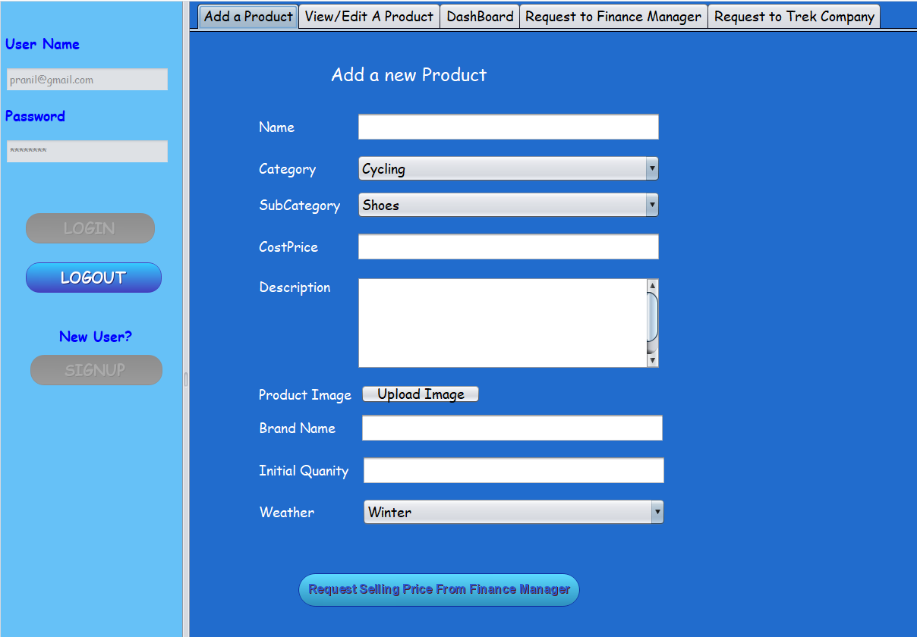
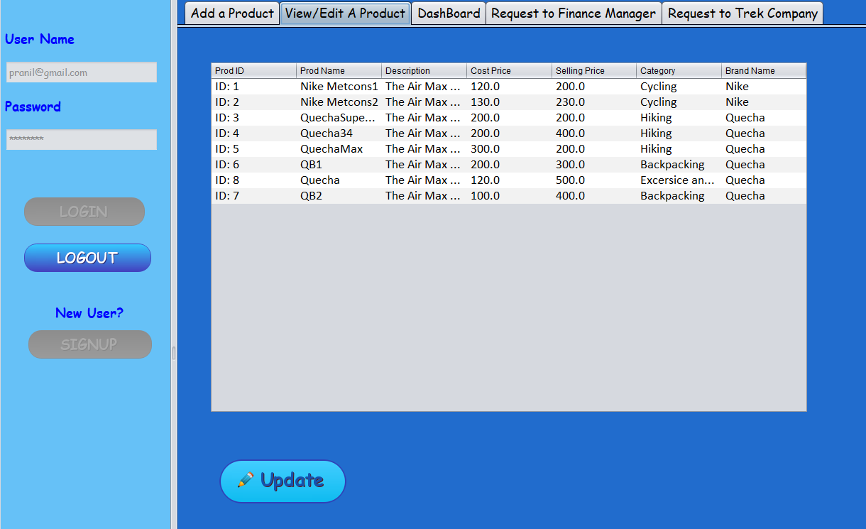
Sports Store Manager Work Flow

Slide 23
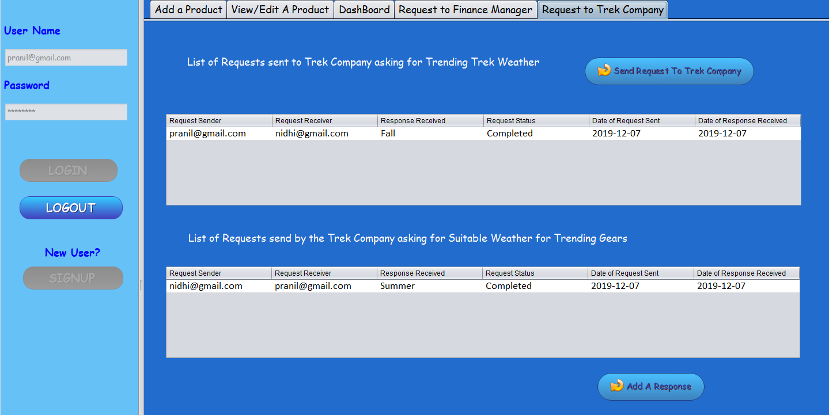
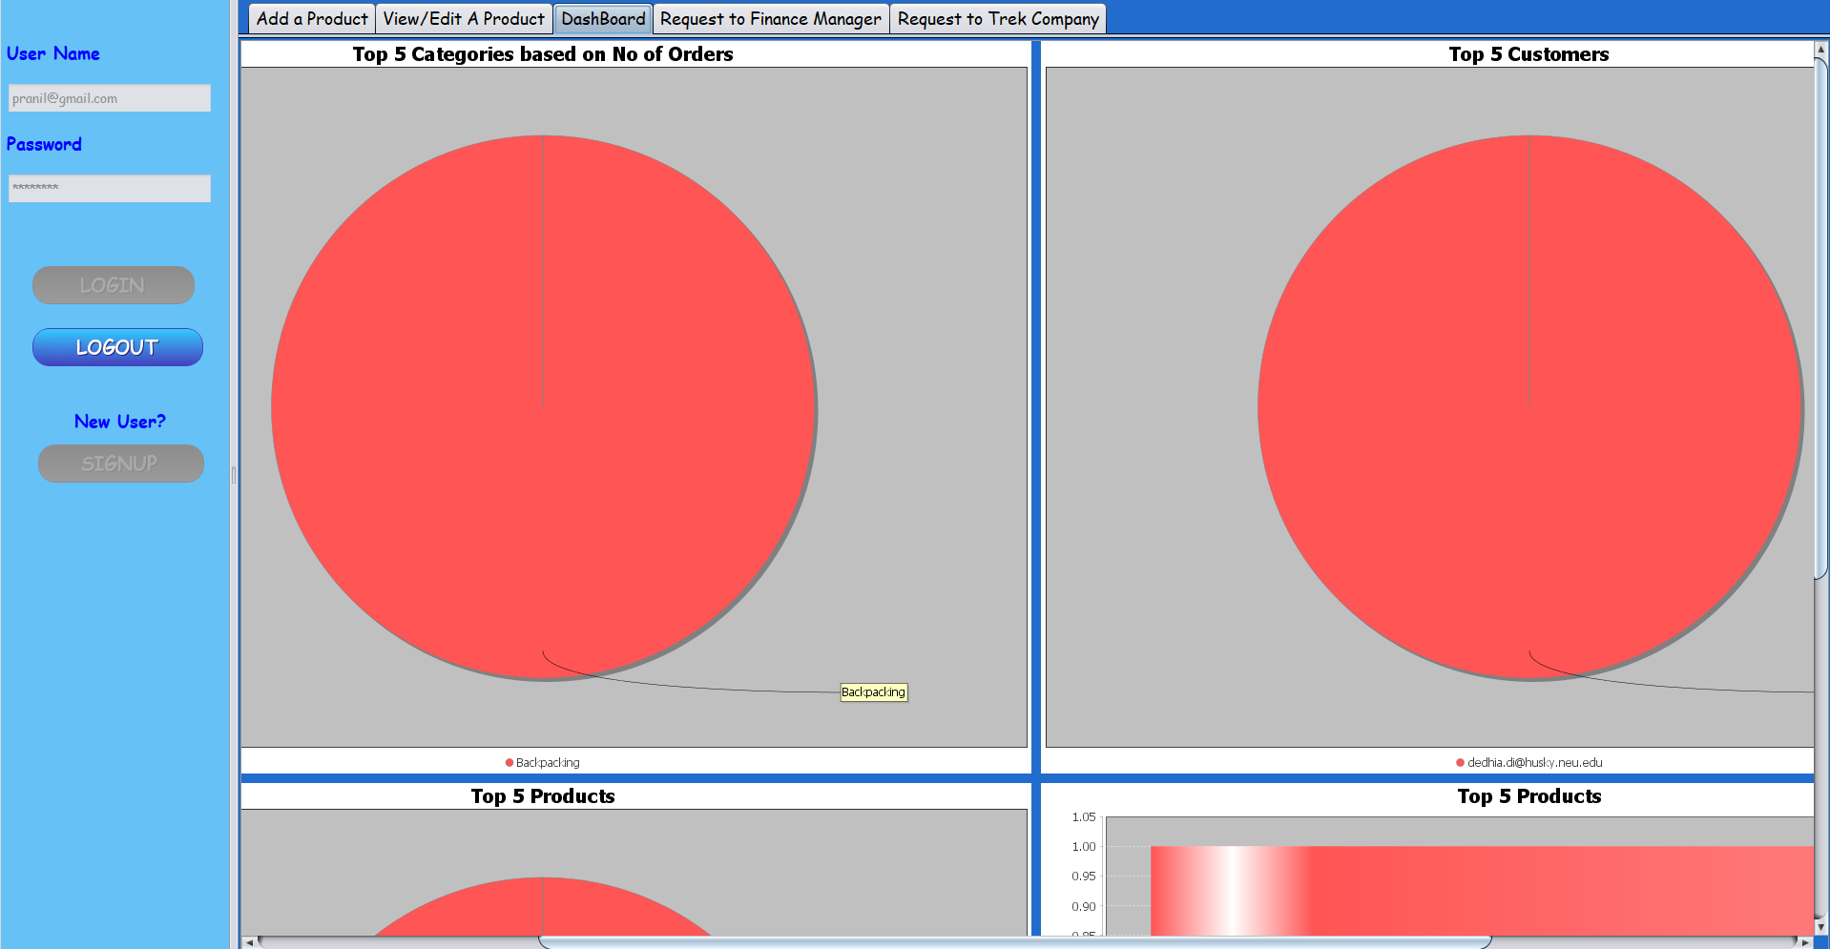
Sports Store Manager Work Flow

Slide 24
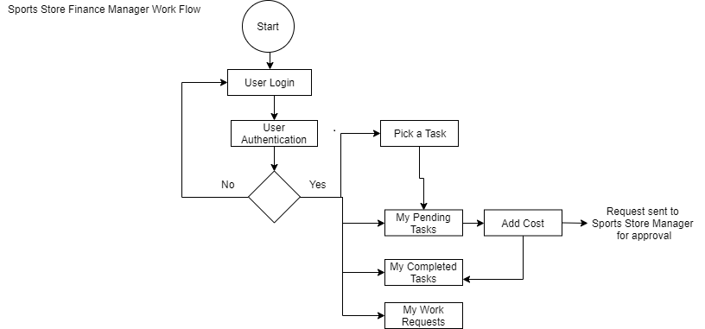
Sports Store Finance Manager

Slide 25
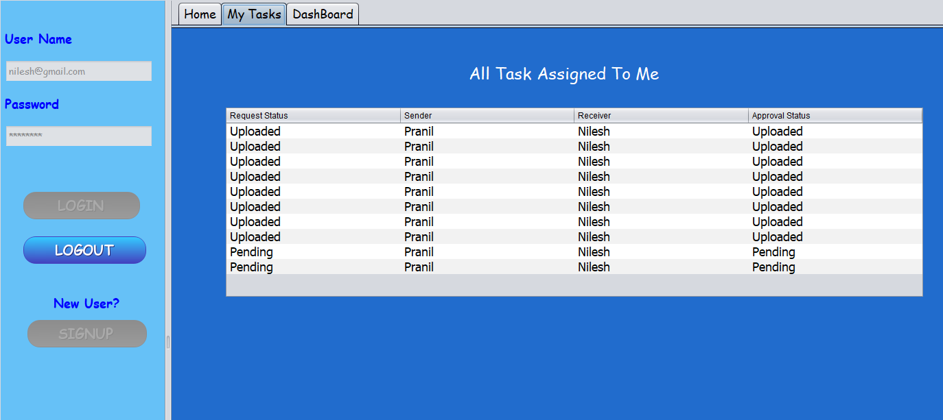
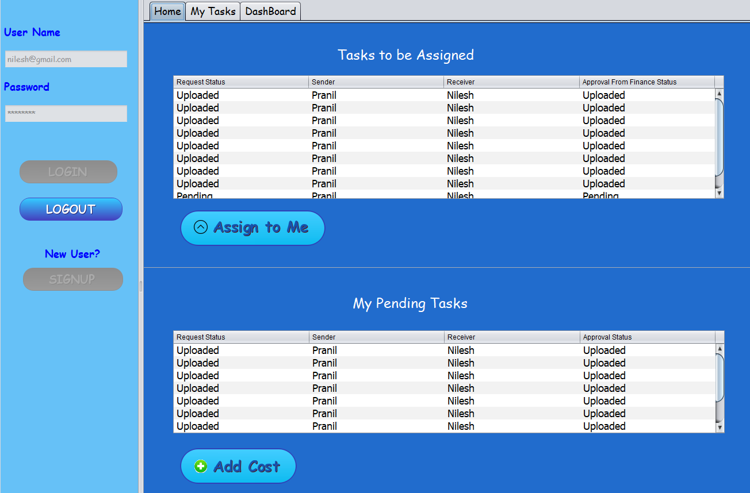
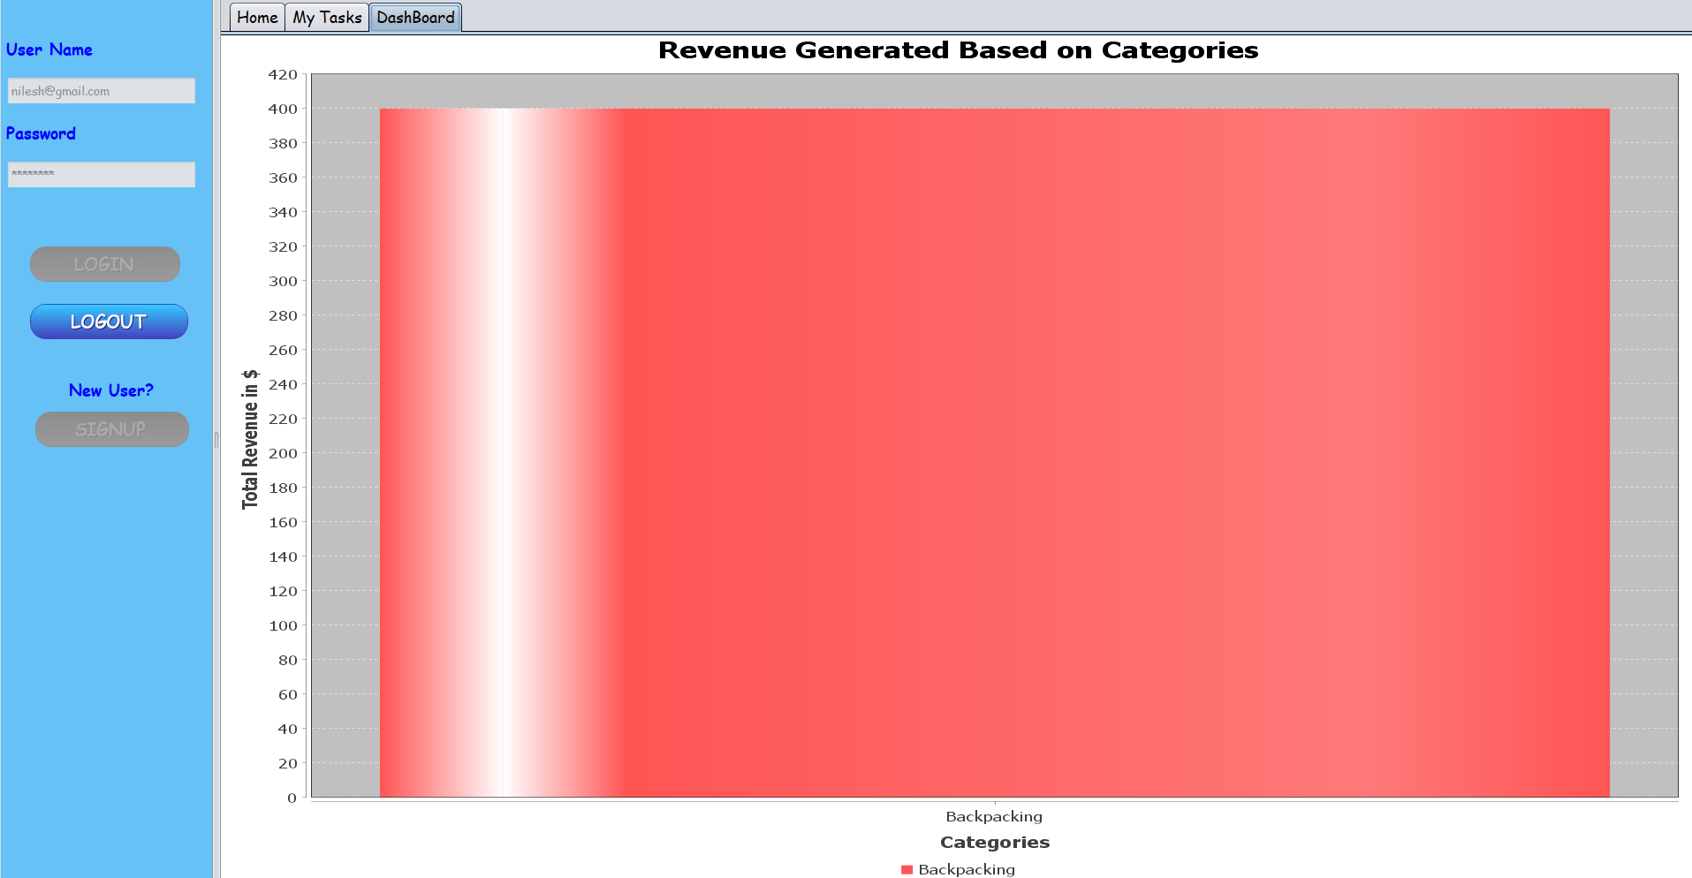
Sports Store Finance Manager

Slide 26
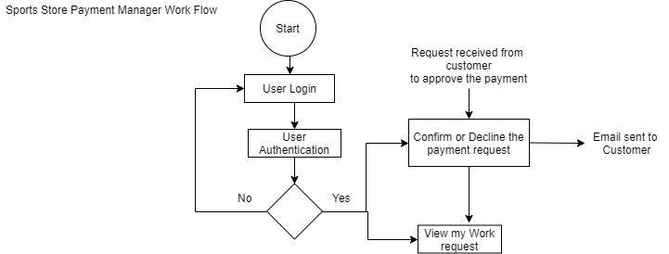
Sports Store Payment Manager

Slide 27
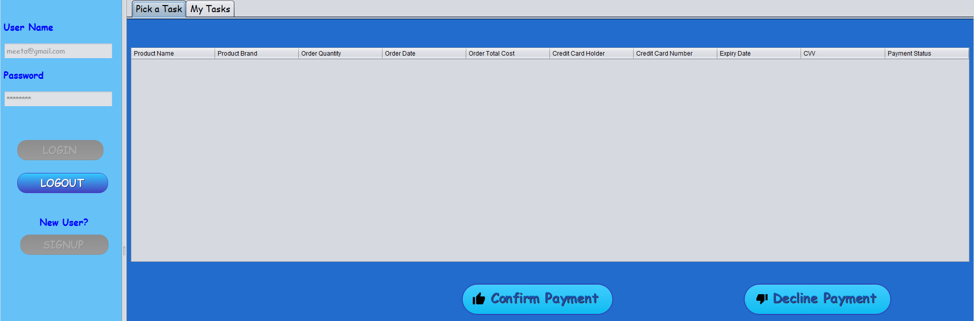
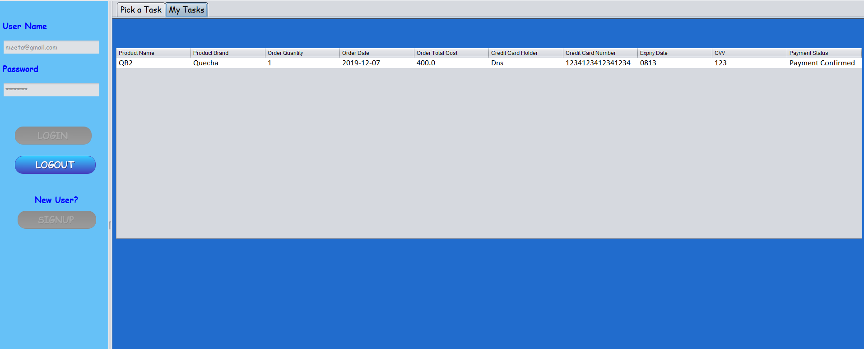
Sports Store Payment Manager

Slide 28
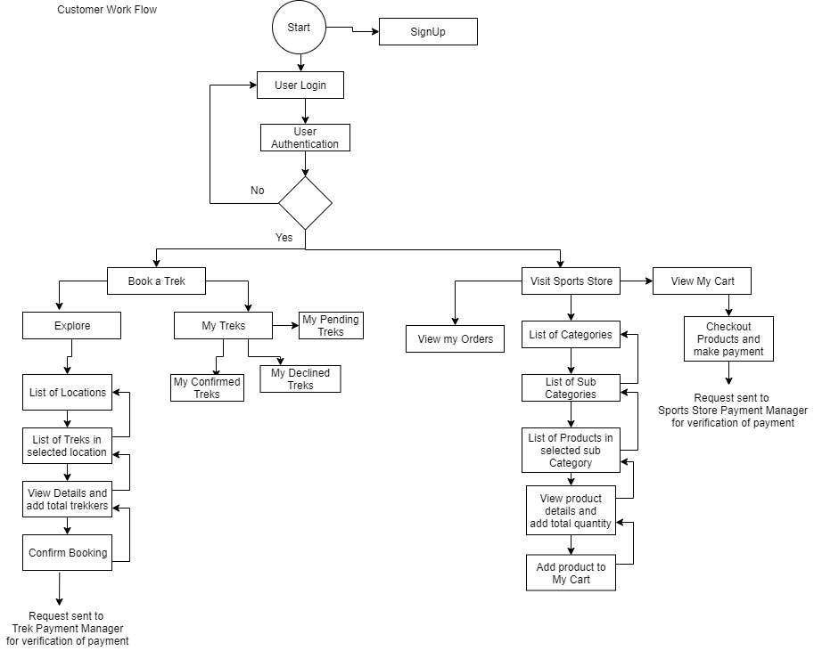
Customer Work Flow

Slide 29
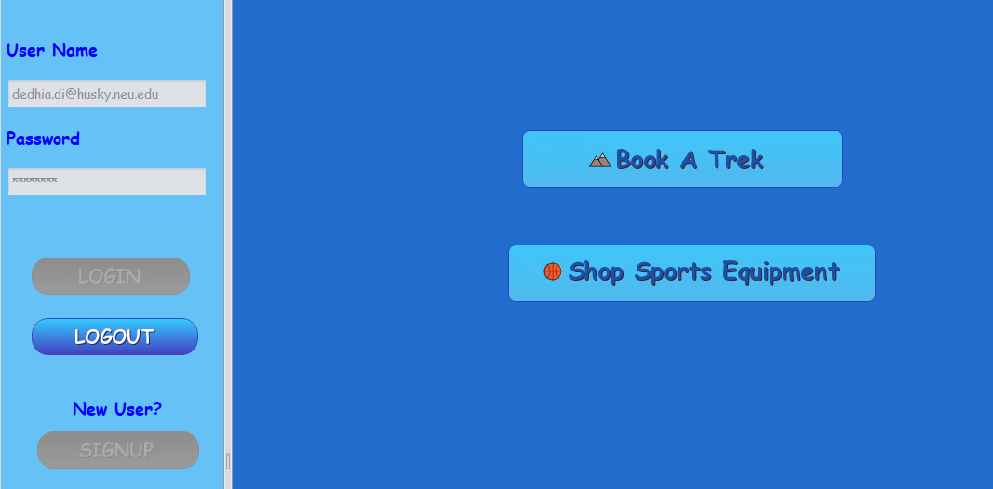
Customer Work Flow

Slide 30
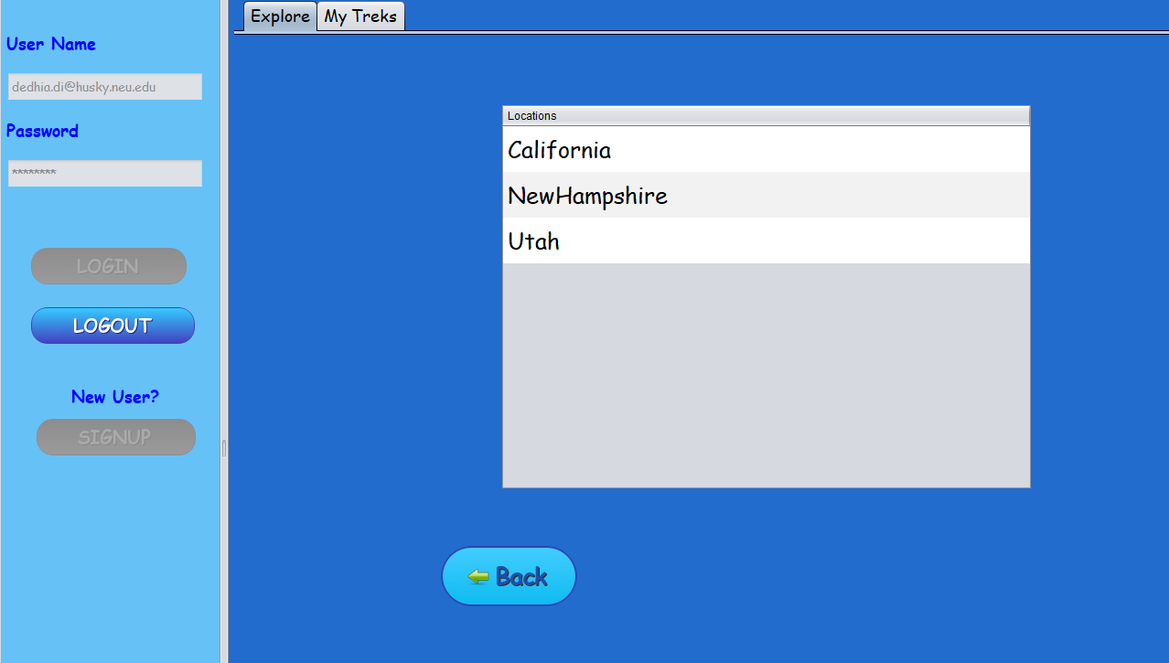
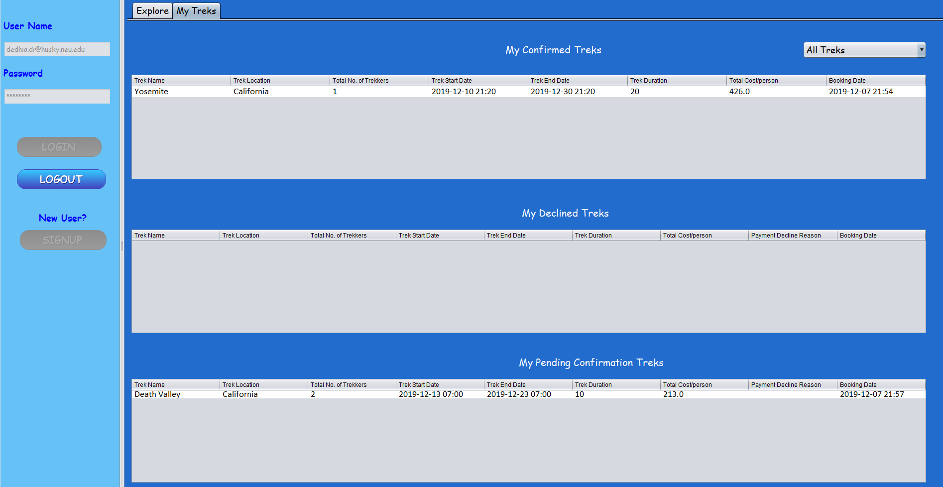
Customer Work Flow

Slide 31
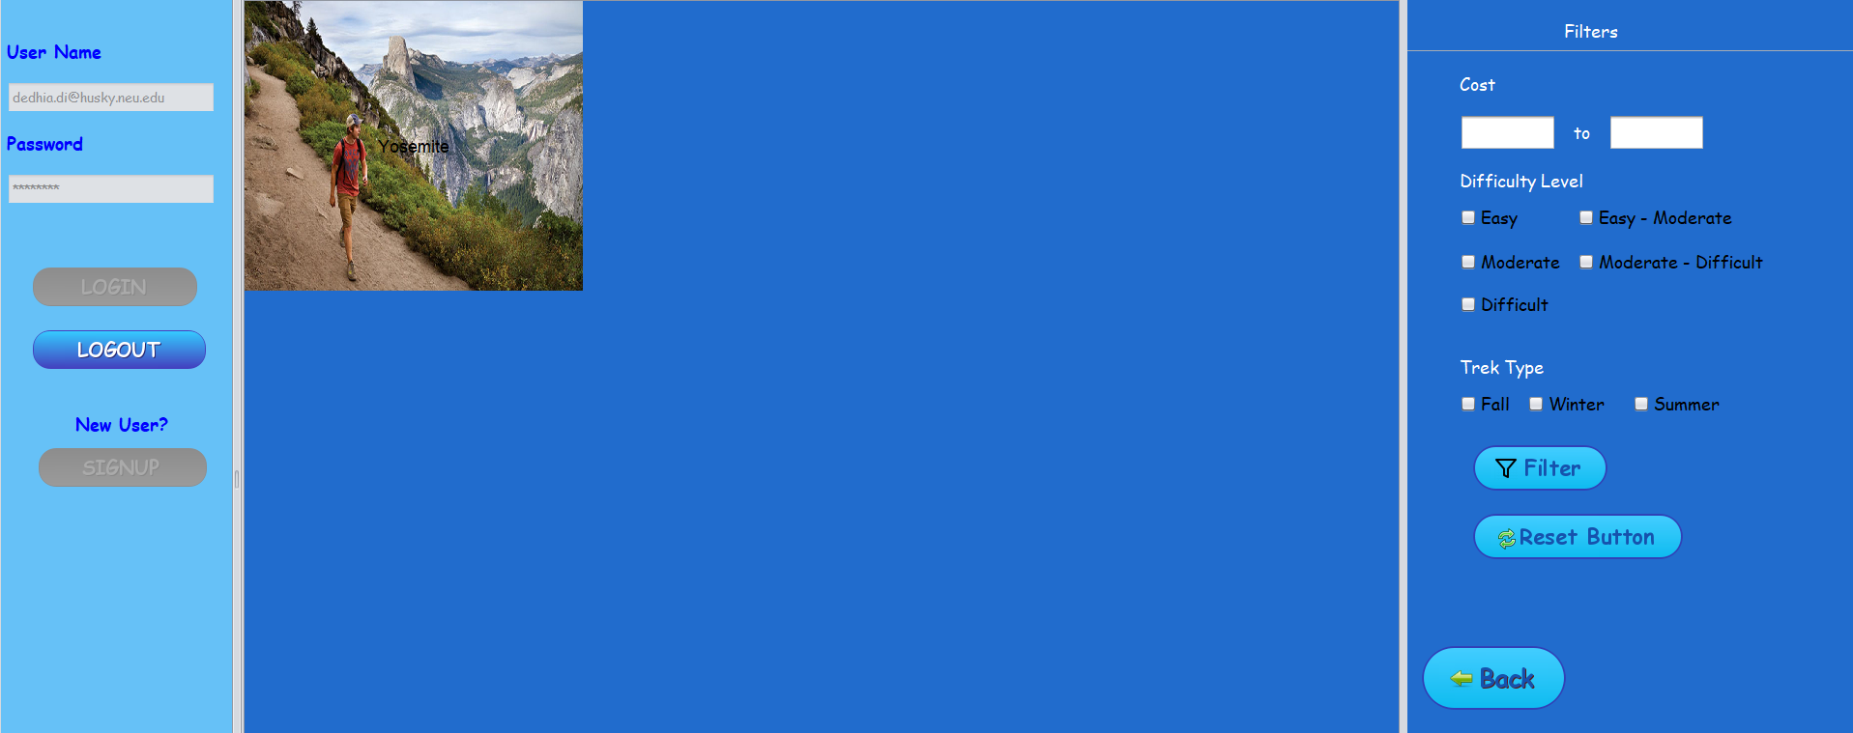
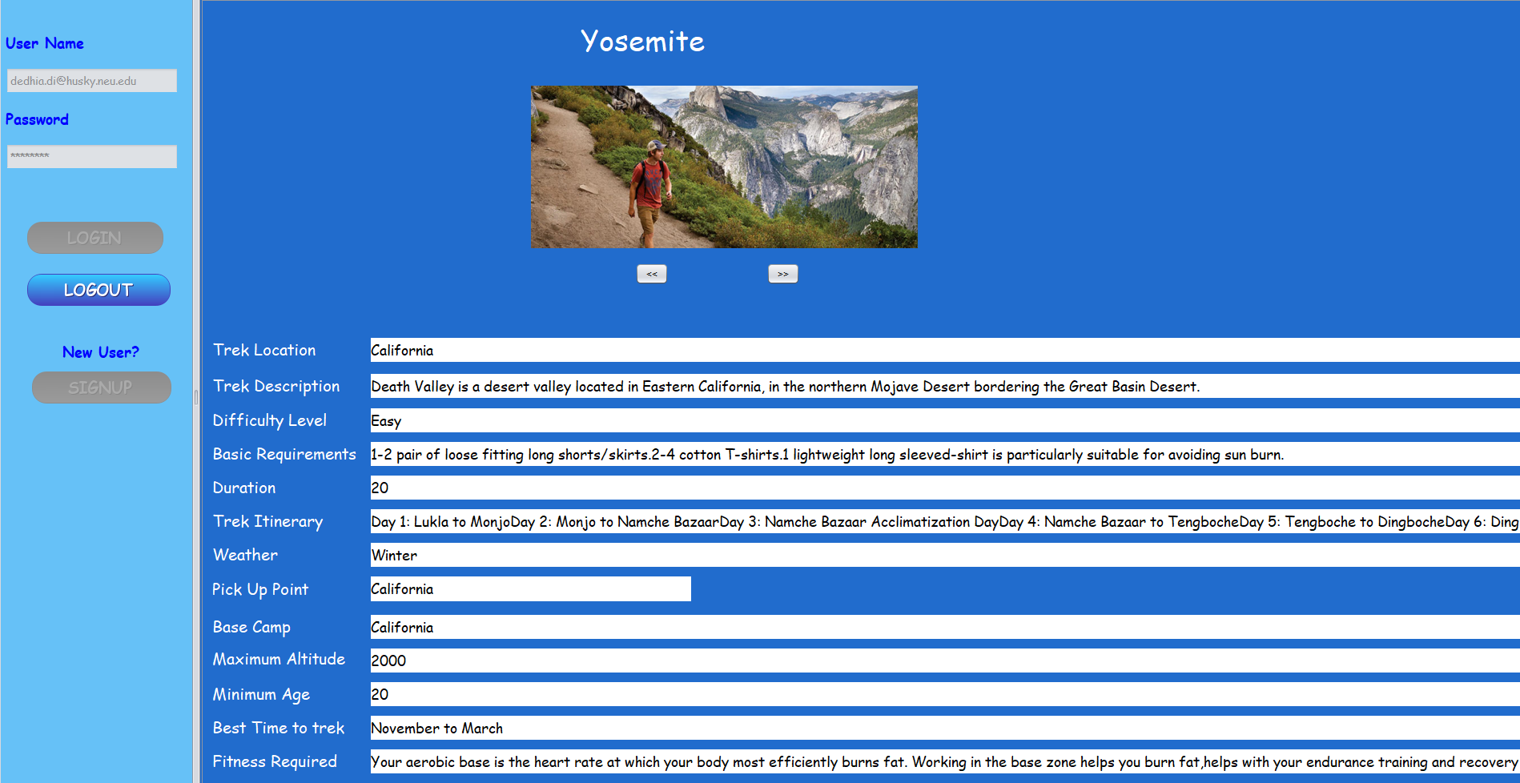

Customer Work Flow

Slide 32

Customer Work Flow

Slide 33



Customer Work Flow

Slide 34



Customer Work Flow

Slide 35
Thank You

